Slide 1


Fundamentals of Web Development
Third Edition by Randy Connolly and Ricardo Hoar
Chapter 13
Server-Side
Development 2: Node.js
Copyright © 2021, 2018, 2015 Pearson Education, Inc. All Rights Reserved

Slide 2
In this chapter you will learn . . .
What is Node.js and how does it differ from PHP
Node’s unique advantages and disadvantages
How to use Node to create a REST API with CRUD functionality
How to use Node with WebSockets to create push-based functionality
How to use a View Engine to provide a PHP-like developer experience
What is serverless computing

Slide 3
Introducing Node.js
Node is like PHP in that a Node application can generate HTML in response to HTTP requests, except it uses JavaScript as its programming language.
Node Advantages
JavaScript Everywhere
Push Architectures
Nonblocking Architectures
Rich Ecosystem of Tools and Code
Broad Adoption

Slide 4
JavaScript Everywhere
Using the same language on both the client and the server has multiple benefits.
Developer productivity is likely to be higher when there is only a single language to use for the entirety of a project.
With a single language, there are also more opportunities for code sharing and reuse when only a single language is being used.
Finally, JavaScript has arguably become the most popular and widely used programming language in the world; this means hiring knowledgeable developers is likely to be easier and that the hiring team only needs to test its potential applicants for knowledge with a single language.

Slide 5
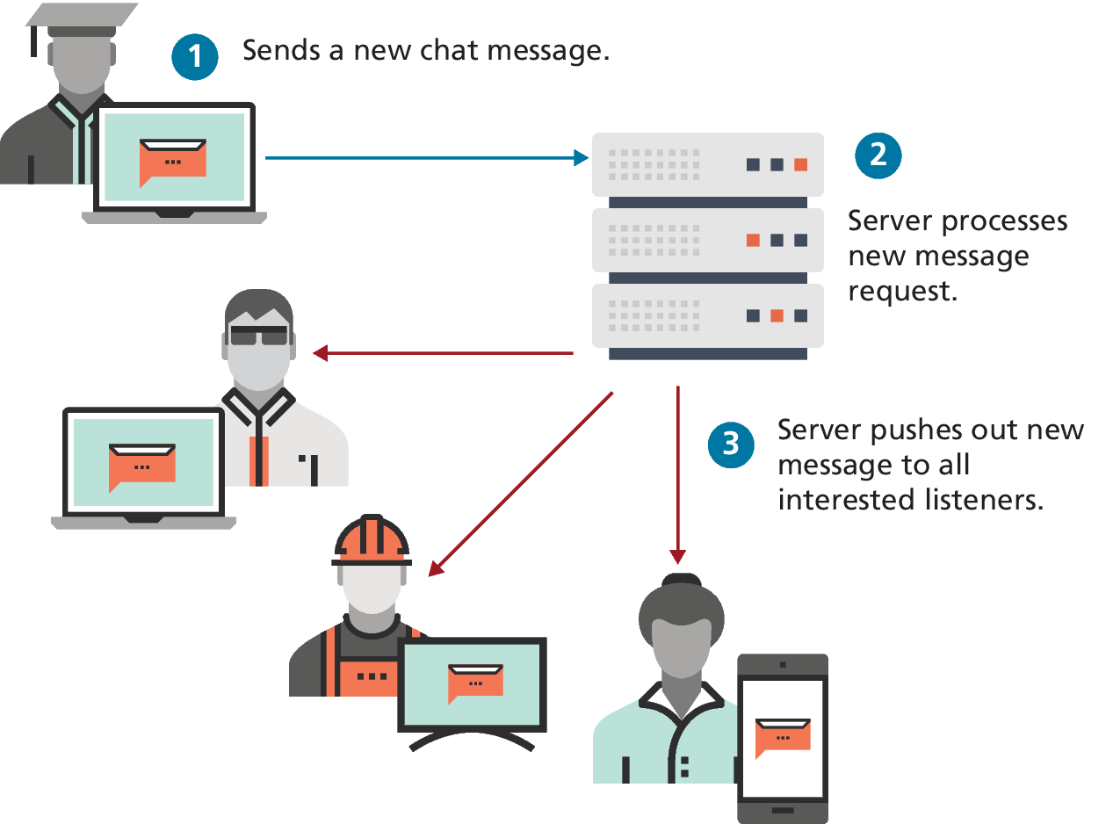
Push Architectures
push-based web applications push information from the server to the client.
Phone calls are push-based: the master phone system pushes out a message (incoming call) to the phone and it responds (by ringing).
The classic example of a push web application is a chat facility housed within a web page.

Slide 6
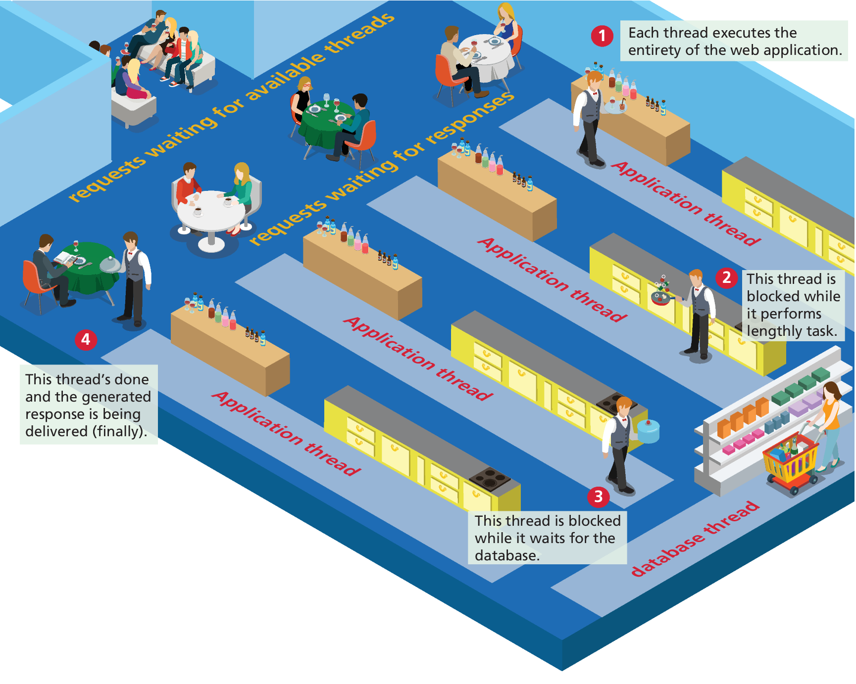
Blocking Architectures
Apache runs applications like PHP using either a blocking multiprocessing or multithreaded model.
Using a restaurant analogy, it would be as though a single person had to handle all the tasks required for each table.

Slide 7
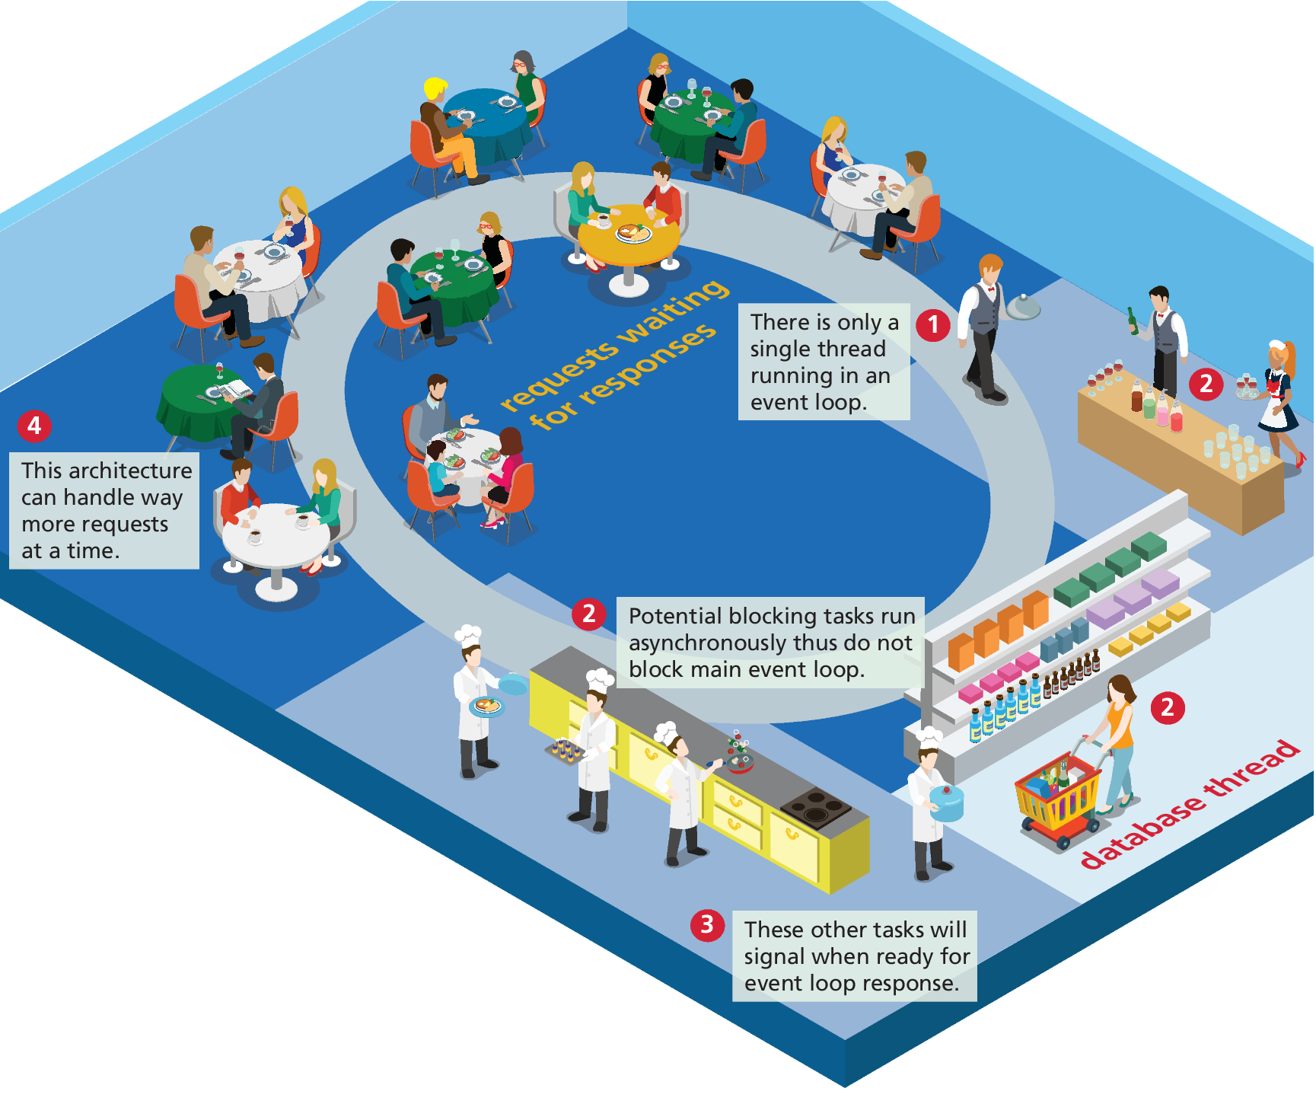
Nonblocking Architectures
Here a single worker is servicing all the requests in a single event loop thread.
This worker can only be doing a single thing a time. But other tasks are delegated to other agents.
Node uses a nonblocking, asynchronous, single-threaded architecture.

Slide 8
Rich Ecosystem and Broad Adoption
Companies from startups to large companies such as eBay, Netflix, Mozilla, GoDaddy, Groupon, Yahoo, Uber, PayPal, and LinkedIn are using
After more than a decade, Node now has an amazingly rich ecosystem of both prebuilt code and tools that make use of Node.
Most new server-based environments either depend on Node or provide Node bindings or APIs. This means that if you want to make use of emerging web development approaches—such as microservices, serverless computing, the Internet of Things, or cloud-service integration—you will find that Node is often a necessity.

Slide 9
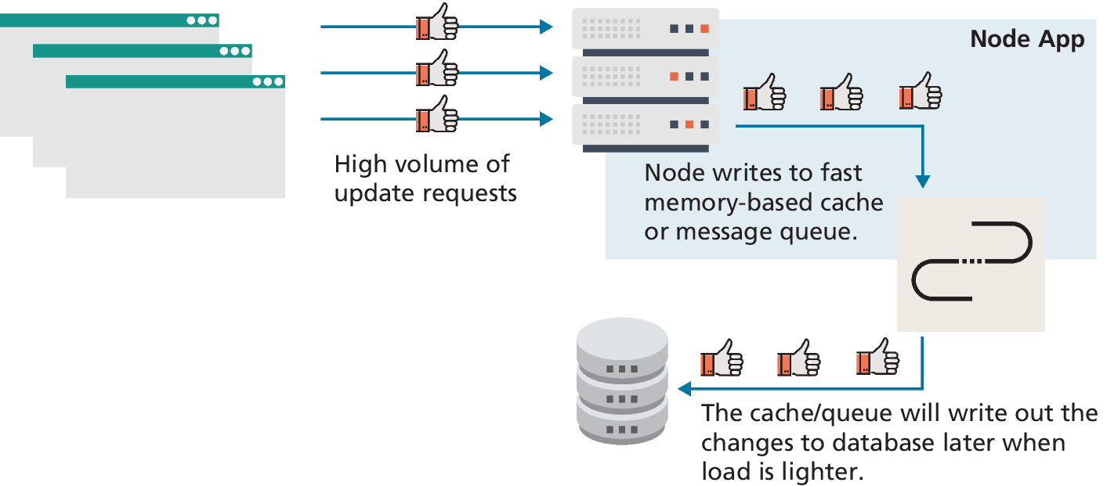
Handling high volume data changes in Node
Node is well suited to developing data-intensive real-time applications that need to interact with distributed computers and whose data sources are noSQL databases.
Consider a simple Like button. It would need to handle a massive number of concurrent data writes.
A Node-based system could make use of a memory-based message queueing system that would keep a record of all data changes, and then those changes could eventually be persisted

Slide 10
Node Disadvantages
Node isn’t ideal for all web-based applications. For sites whose data is in a traditional relational database such as MySQL, accessing that data in Node is often a complex programming task.
The single-thread nonblocking architecture of Node is also not ideal for computationally heavy tasks, such as video processing or scientific computing
Applications in Node can be more significantly more complex to develop and maintain than in PHP or in client-side JavaScript

Slide 11
Simple Node Application
// make use of the http module
const http = require('http’);
// configure HTTP server to respond with simple message to all requests
const server = http.createServer(function (request, response) {
response.writeHead(200, {"Content-Type": "text/plain"});
response.write("Hello this is our first node.js application");
response.end();
});
// Listen on port 8080 on localhost
const port = 8080;
server.listen(port);
// display a message on the terminal
console.log("Server running at port=" + port);
LISTING 13.1 Hello World in Node

Slide 12
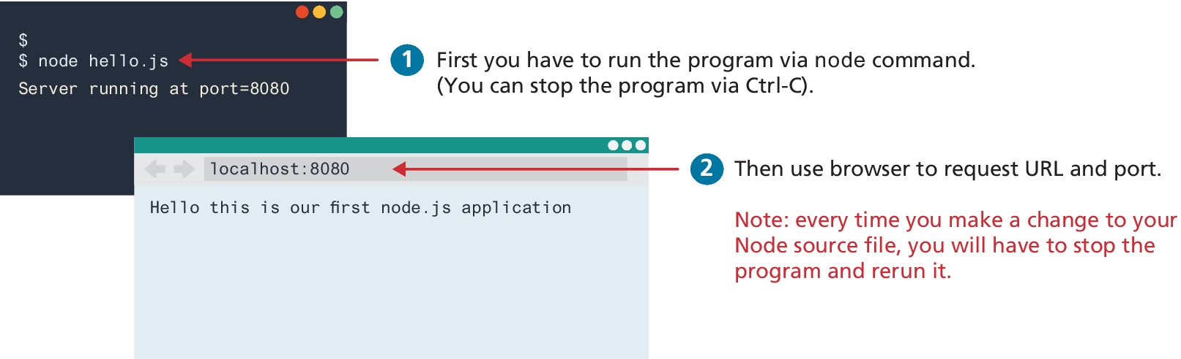
Running the Hello World example
If you have installed Node, you will need to open a command/terminal window, navigate to the folder for hello.js , and enter the following command:
node hello.js
In a browser, make a request for localhost on port 8080.

Slide 13
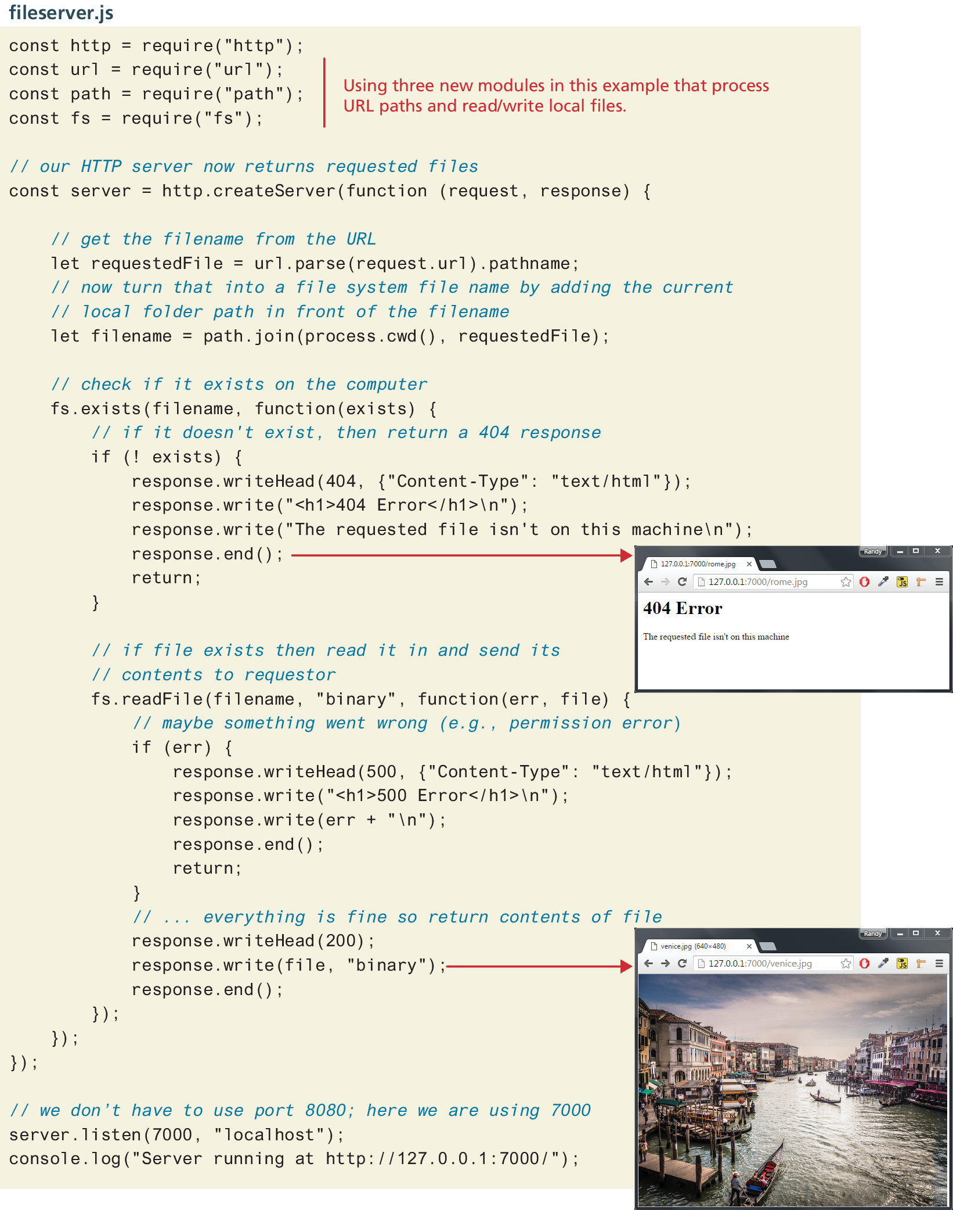
Static file server example

Slide 14
Adding Express
One of the most popular preexisting modules is Express, where you typically write handlers for the different routes in your application. A route is a URL, a series of folders or files or parameter data within the URL.
The request object contains a params object that holds any parameter data included with the request/route. The response object provides methods for setting HTTP headers and cookies, sending files or JSON data, and so on. A simple file server using the static() function:
var express = require("express");
var app = express();
app.use("/static", express.static(path.join(__dirname, "public")));
app.listen(8080, () => { ... });

Slide 15
A middleware function
One of the most popular preexisting modules is Express, where you typically write handlers for the different routes in your application. A route is a URL, a series of folders or files or parameter data within the URL.
The request object contains a params object. The response object provides methods for setting HTTP headers and cookies, sending files or JSON data, and so on. A simple file server using the static() function would be:
var express = require("express");
var app = express();
app.use("/static", express.static(path.join(__dirname, "public")));
app.listen(8080, () => { ... });
The app.use() function executes the provided middleware function

Slide 16
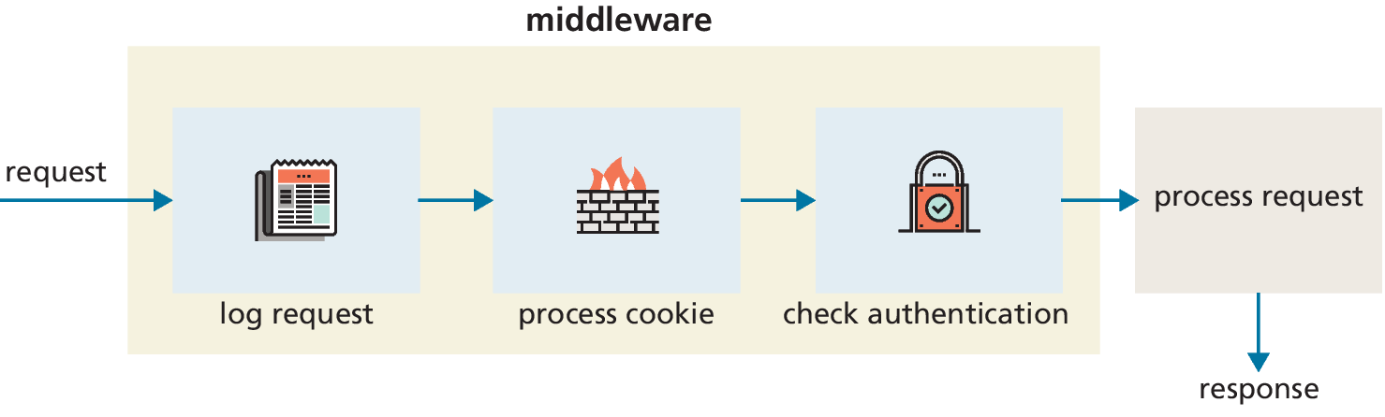
Middleware functions in Express

Slide 17
Environment Variables
Environment variables provide a mechanism for configuring your Node application. To see your variables:
console.log(process.env);
You can set your environment variables using the popular dotenv package. Use an environment file named .env to store any number of name=value pairs, such as:
PORT=8080
BUILD=development
Within your Node applications, you can reference the values in this file
// make use of dotenv package
require('dotenv').config();
// reference values from the .env file
console.log("build type=" + process.env.BUILD);
server.listen(process.env.PORT);

Slide 18
Creating an API in Node
In Chapters 10 and 11, you consumed external APIs using fetch.
You might have wondered how these APIs were created. While you could use any server-side technology to implement an API, Node is a particularly popular technology for doing so.
Most REST APIs are HTTP front-ends for querying a database. As such, you will learn how to create a database-driven API in the next chapter on databases.

Slide 19
Simple API
Listing 13.3 provides the code for a very simple API that reads in a JSON data file and then returns the JSON data when the URL is requested.
// first reference required modules
const fs = require('fs');
const path = require('path');
const express = require('express');
const app = express();
// for now, we will read a json file from public folder
const jsonPath = path.join(__dirname, 'public', 'companies.json’);
// get data using conventional Node callback approach
let companies;
fs.readFile(jsonPath, (err,data) => {
if (err)
console.log('Unable to read json data file’);
else
companies = JSON.parse(data);
});
// return all the companies when a root request arrives
app.get('/', (req,resp) => { resp.json(companies) } );
// Use express to listen to port
let port = 8080;
app.listen(port, () => {
console.log("Server running at port= " + port);
});
LISTING 13.3 Simple API using callback approach

Slide 20
Adding Routes
To make the web service created in the previous section more useful, let’s add some routes
/companies/:symbol for a single company object
/companies/name/:substring, which will return all companies whose name contains the supplied substring.
// return all the companies if a root request arrives
app.get('/', (req,resp) => { resp.json(companies) } );
// return just the requested company, e.g., /companies/amzn
app.get('/companies/:symbol', (req,resp) => {
const symbolToFind = req.params.symbol.toUpperCase();
const matches =
companies.filter(obj => symbolToFind === obj.symbol);
resp.json(matches);
});
// return companies whose name contains the supplied text,
app.get('/companies/name/:substring', (req,resp) => {
const substring = req.params.substring.toLowerCase();
const matches = companies.filter( (obj) =>
obj.name.toLowerCase().includes(substring) );
resp.json(matches);
});
LISTING 13.4 Adding routes to API

Slide 21
Separating Functionality into Modules
What if we had five or six or more routes? In such a case, our single Node file would start becoming too complex. A better approach would be to separate out the routing functionality into separate modules.
A module in the traditional CommonJS approach in Node is similar to how you created modules in Chapter 10, except rather than using the JavaScript export keyword, you instead set the export property of the module object.
You could also place your route handler logic into a separate module.

Slide 22
Defining a module
...
const fs = require('fs').promises;
// for now, we will get our data by reading the provided json file
const jsonPath = path.join(__dirname, '../public', 'companies.json’);
let companies;
getCompanyData(jsonPath);
async function getCompanyData(jsonPath) {
try {
const data = await fs.readFile(jsonPath, "utf-8");
companies = JSON.parse(data);
}
catch (err) { console.log('Error reading ' + jsonPath); }
}
function getData() {
return companies;
}
// specifies which objects will be available outside of module
module.exports = { getData };
LISTING 13.5 Defining a module

Slide 23
Creating a CRUD API
It is common to use different HTTP verbs to signal whether we want to create, retrieve, update, or delete (CRUD) data.
It is convention to use GET for retrieve requests, POST for create requests, PUT for update requests, and DELETE for delete requests.
For now, our example here will simply modify the in-memory data
const handleSingleSymbol = (companyProvider, app) => {
app.get('/companies/:symbol', (req,resp) => {
…
});
app.put('/companies/:symbol', (req,resp) => {
...
});
app.post('/companies/:symbol', (req,resp) => {
...
});
app.delete('/companies/:symbol', (req,resp) => {
...
});
};

Slide 24
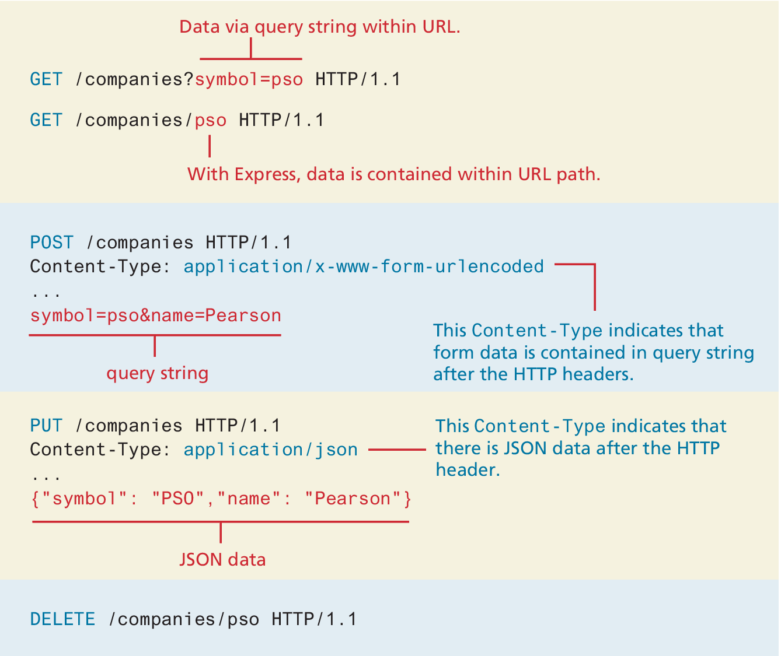
Passing Data to an API
Recall that form data sent via GET is included via query string parameters added to the URL, while form data sent via POST adds the query string to the request after the HTTP header.
The browser also sets the Content-Type HTTP header to application/x-www-form-urlencoded.
It is possible to also send plain text, JSON or XML data, or file content. To do so requires setting the Content-Type header to the appropriate value.

Slide 25
API Testing Tools
API developers often make use of some type of third-party API testing tool such as Postman or Insomnia
With these tools you specify the URL endpoint to request, and have full control over which HTTP verbs to use, which Content-Type header to use, and can easily input the data to send.
Working with Web Sockets

Slide 26
Working with Web Sockets
WebSockets is an API that makes it possible to open an interactive (two-way) communication channel between the browser and a server that doesn’t use HTTP (except to initiate the communication).
Since Socket.io is not part of the default Node system, to use it you will need to add it to your project via the command:
npm install socket.io
It consists of two files:
The Node server application (chat-server.js)
The browser client file (chat-client.html)

Slide 27
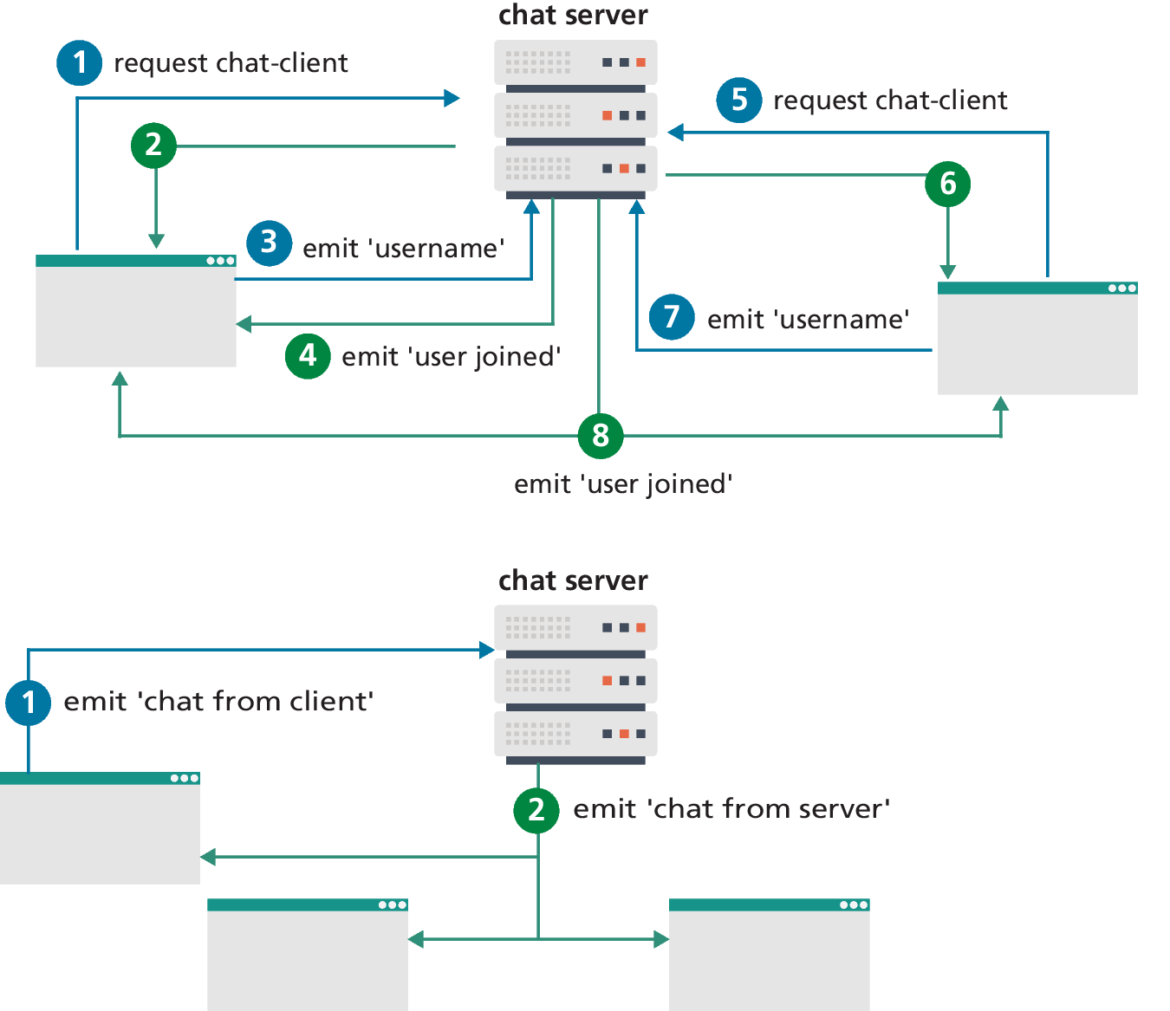
Message flow using Socket.io
The socket.io() function handles the reception of messages from clients.
In Listing 13.9, the server application handles two types of message from its clients: a username message and a chat from client message. The actual message names can be anything you’d like.
A message is broadcast (or pushed) to all connected clients via the io.emit() function.

Slide 28
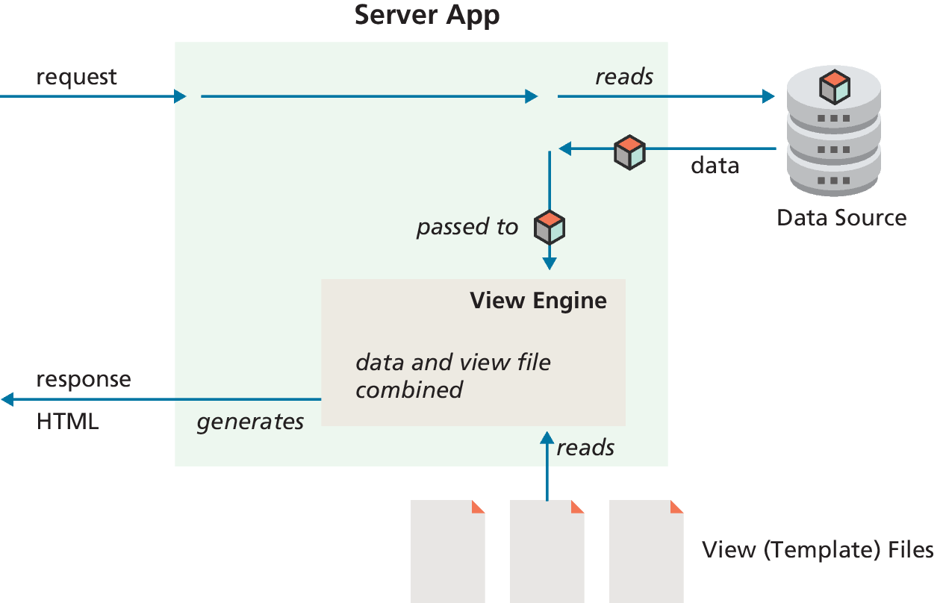
View Engines
It is also possible to use Node in a way similar to PHP: that is, to use JavaScript in Node to generate HTML using a view engine
You only need to install the appropriate package using npm, and then tell Express which folder contains the view files and which view engine to use to display those files.

Slide 29
Example EJS view
<!DOCTYPE html>
<html lang="en">
<head>
<meta charset="utf-8">
<title>EJS Test</title>
<link rel="stylesheet" href="/static/list.css" />
</head>
<body><main>
<h1><%= title %></h1>
<section class="container">
<% for (let p of paintings) { %>
<div class="box">
<img src="<%= p.filename %>" />
<h2><%= p.artist %></h2>
<p><%= p.title %> (<%= p.year %>)</p>
<button>View</button>
</div>
<% } %>
</section> </main> </body> </html>
LISTING 13.11 Example EJS view

Slide 30
Serverless Approaches
Serverless computing is a way of deploying and running web applications that make use of third-party services and cloud platforms that replace the need to install, configure, and update back-end environments. The term serverless is a bit of misnomer in that servers certainly are being used; it is serverless in that you or your team no longer worry.
The serverless approach “is not eliminating complexity, it’s making that complexity someone else’s responsibility.”

Slide 31
Benefits of Serverless Computing
As indicated in the introduction, the main benefit of serverless is that it reduces complexity. There is no need to configure and support server software on your own.
By eliminating the need to provision servers, the serverless approach often results in lower costs.
Serverless doesn’t eliminate servers: it just outsources them to services that can specialize in their support. As such, it generally provides better reliability, scalability, and security.

Slide 32
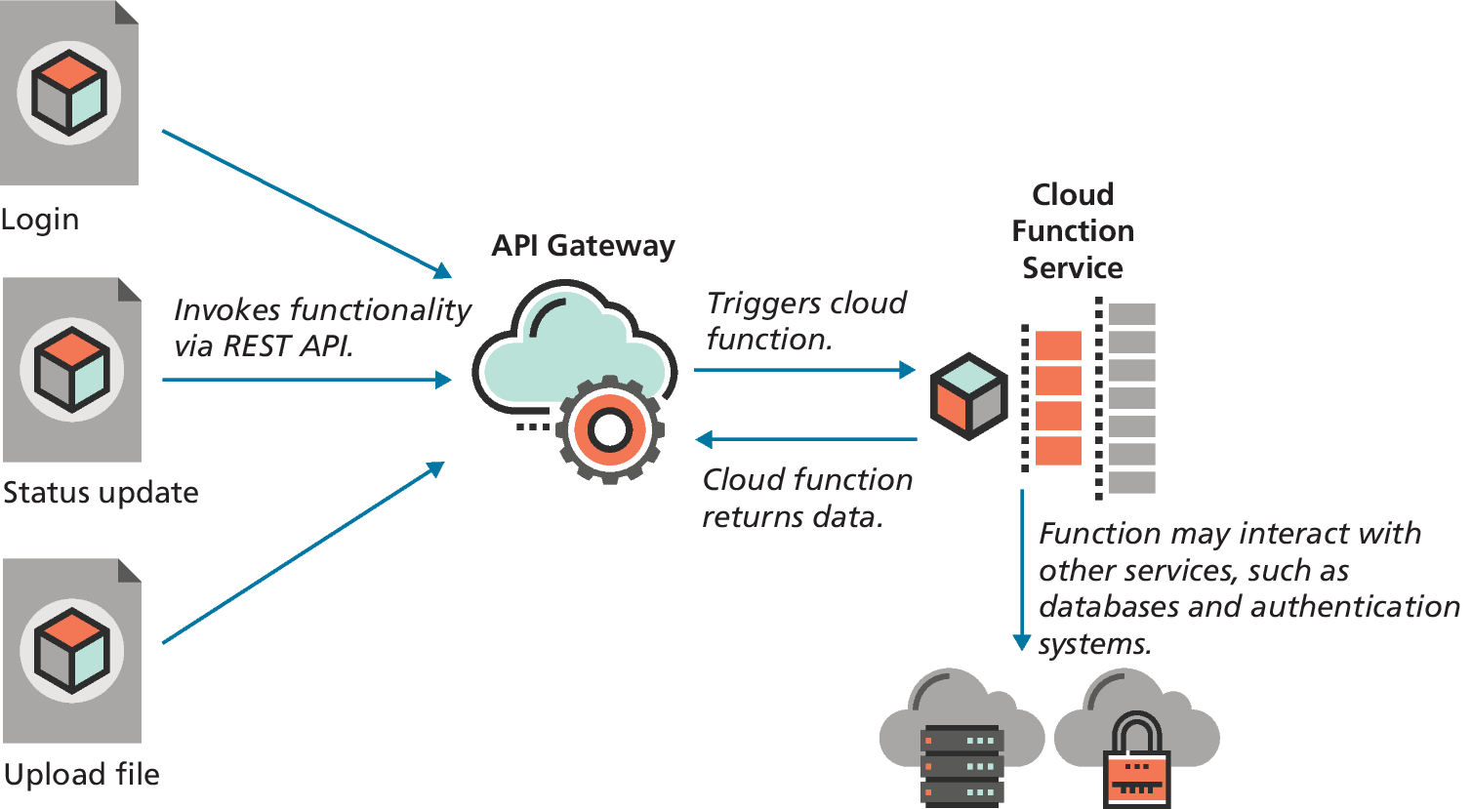
Serverless Technologies
Databases-as-a-Service
Platform-as-a-Service (PaaS)
Functions-as-a-Service (FaaS)

Slide 33
Key Terms
CommonJS
CRUD
Database-as-a-Service
Environment variables
Express
Functions-as-a-Service
JAM Stack
middleware
module
Node
nonblocking
npm
Platform-as-a-Service
push-based
route
serverless computing
templates
V8
views
view engine
WebSockets

Slide 34

Copyright
This work is protected by United States copyright laws and is provided solely for the use of instructors in teaching their courses and assessing student learning. Dissemination or sale of any part of this work (including on the World Wide Web) will destroy the integrity of the work and is not permitted. The work and materials from it should never be made available to students except by instructors using the accompanying text in their classes. All recipients of this work are expected to abide by these restrictions and to honor the intended pedagogical purposes and the needs of other instructors who rely on these materials.

